Slide 1
Comparison of Ra, Rq, Sa and Sq for the 16 samples from top view with x5 magnification.

Slide 2
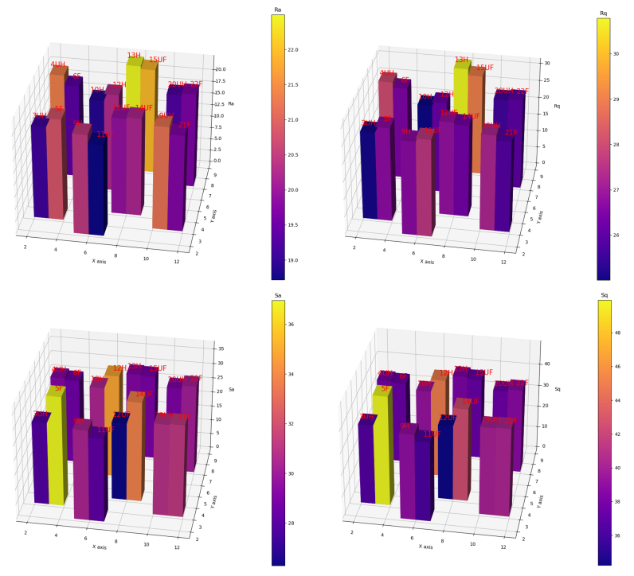

Slide 3
Ra

Slide 4
Rq

Slide 5
Sa

Slide 6
Sq

Slide 7
Comparison of Ra, Rq, Sa and Sq for the 16 samples from top view with x20 magnification.

Slide 8
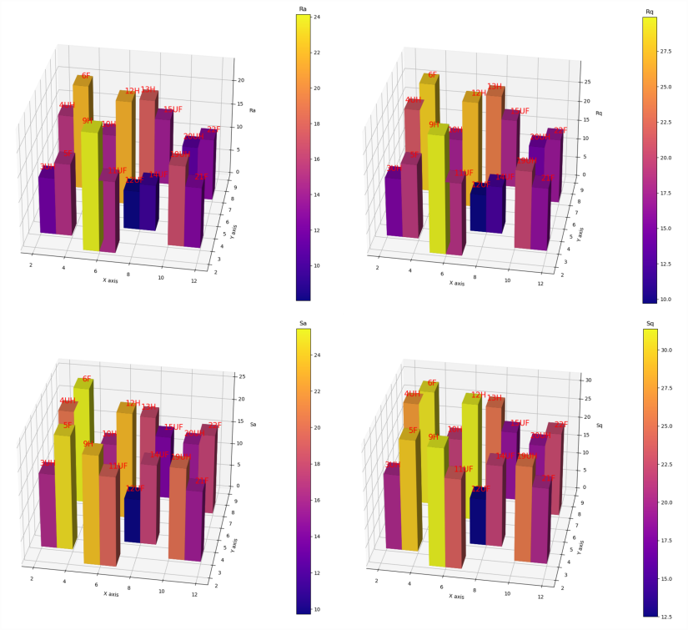

Slide 9
Comparison of Ra, Rq, Sa and Sq for the 16 samples from the marked side with x5 magnification. Ra and Rq measurements were repeated twice to visualize eventual error variance.

Slide 10
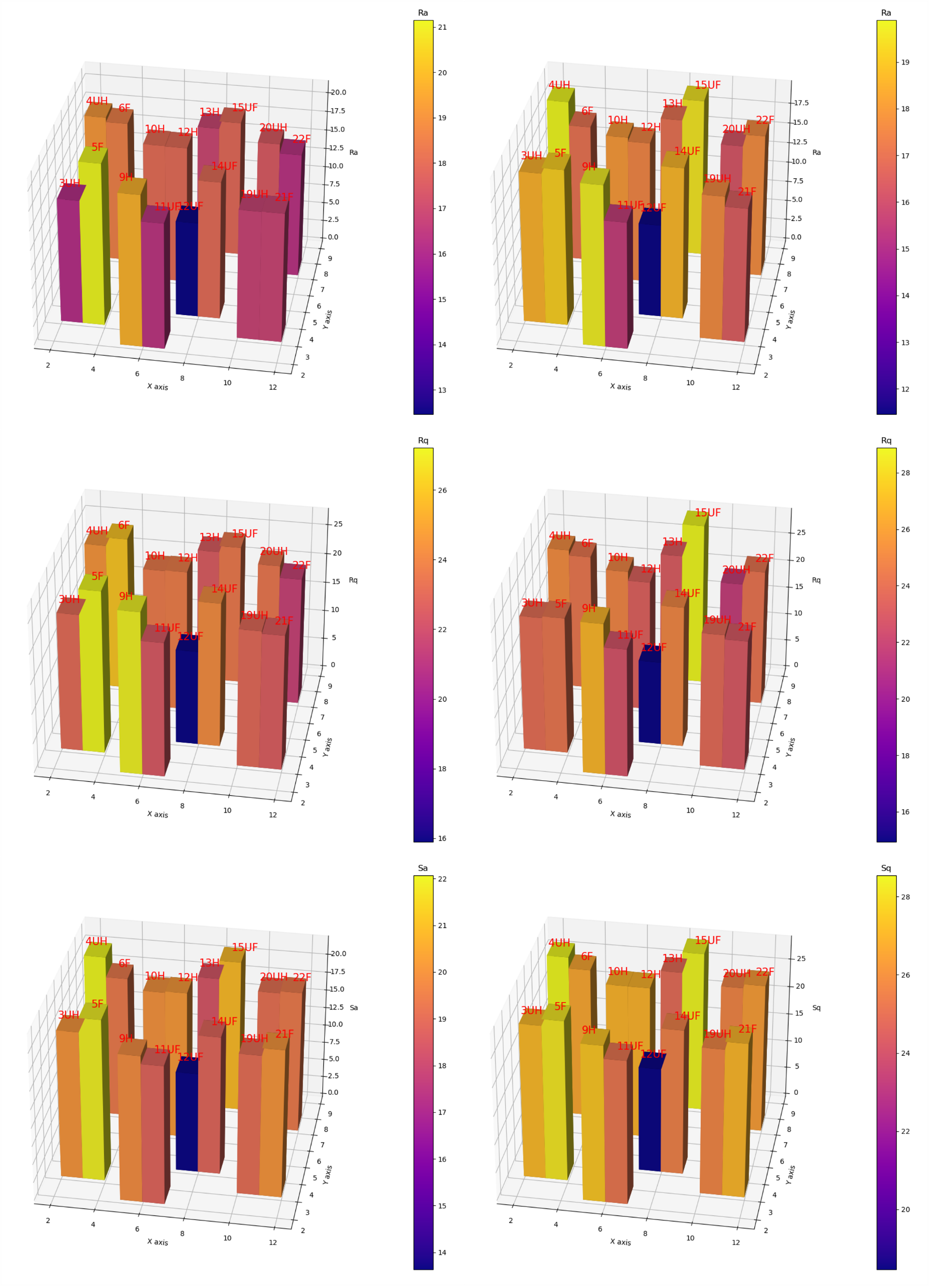

Slide 11
Comparison of Ra, Rq, Sa and Sq for the 16 samples from the bottom with x5 magnification. Ra and Rq measurements were repeated twice to visualize eventual error variance.

Slide 12
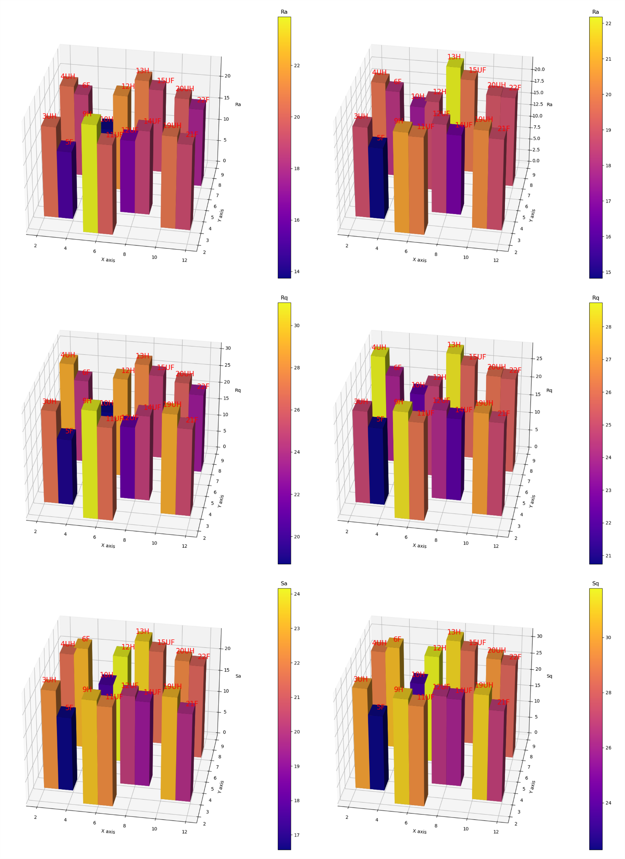

Slide 13
Comparison of D10, D50, D90 and Span for the 16 samples from the top with x10 magnification.

Slide 14
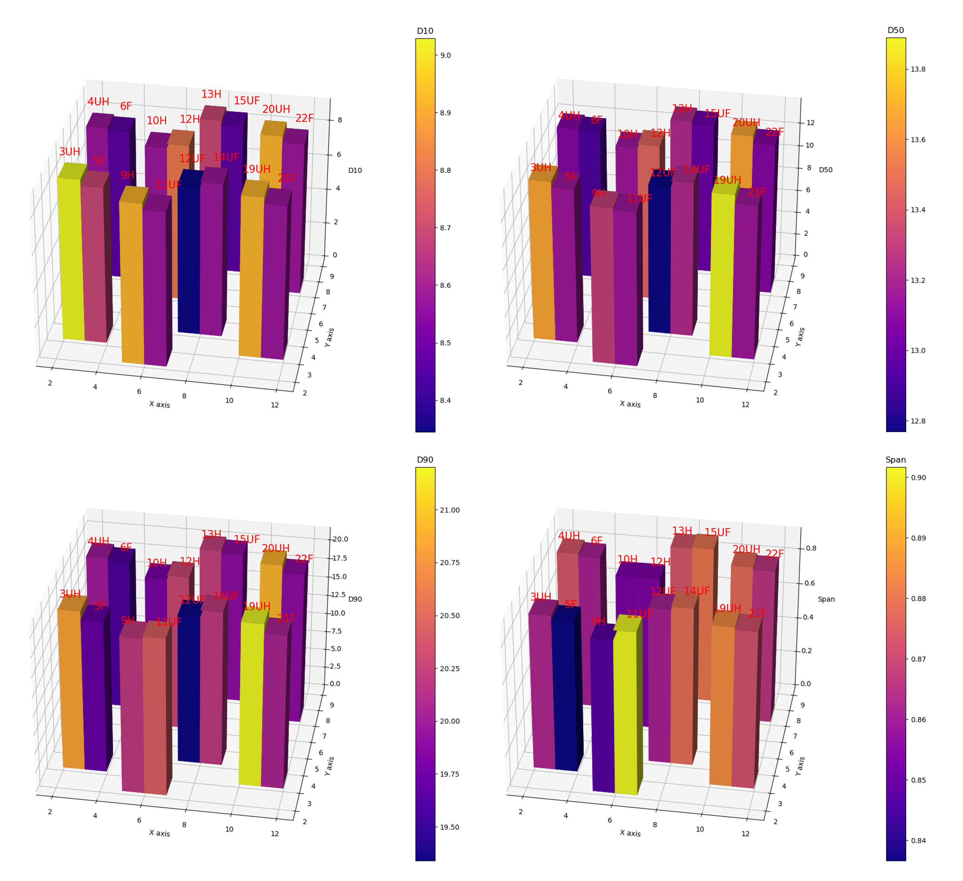

Slide 15
Comparison of D10, D50, D90 and Span for the 16 samples from the top with x20 magnification.

Slide 16
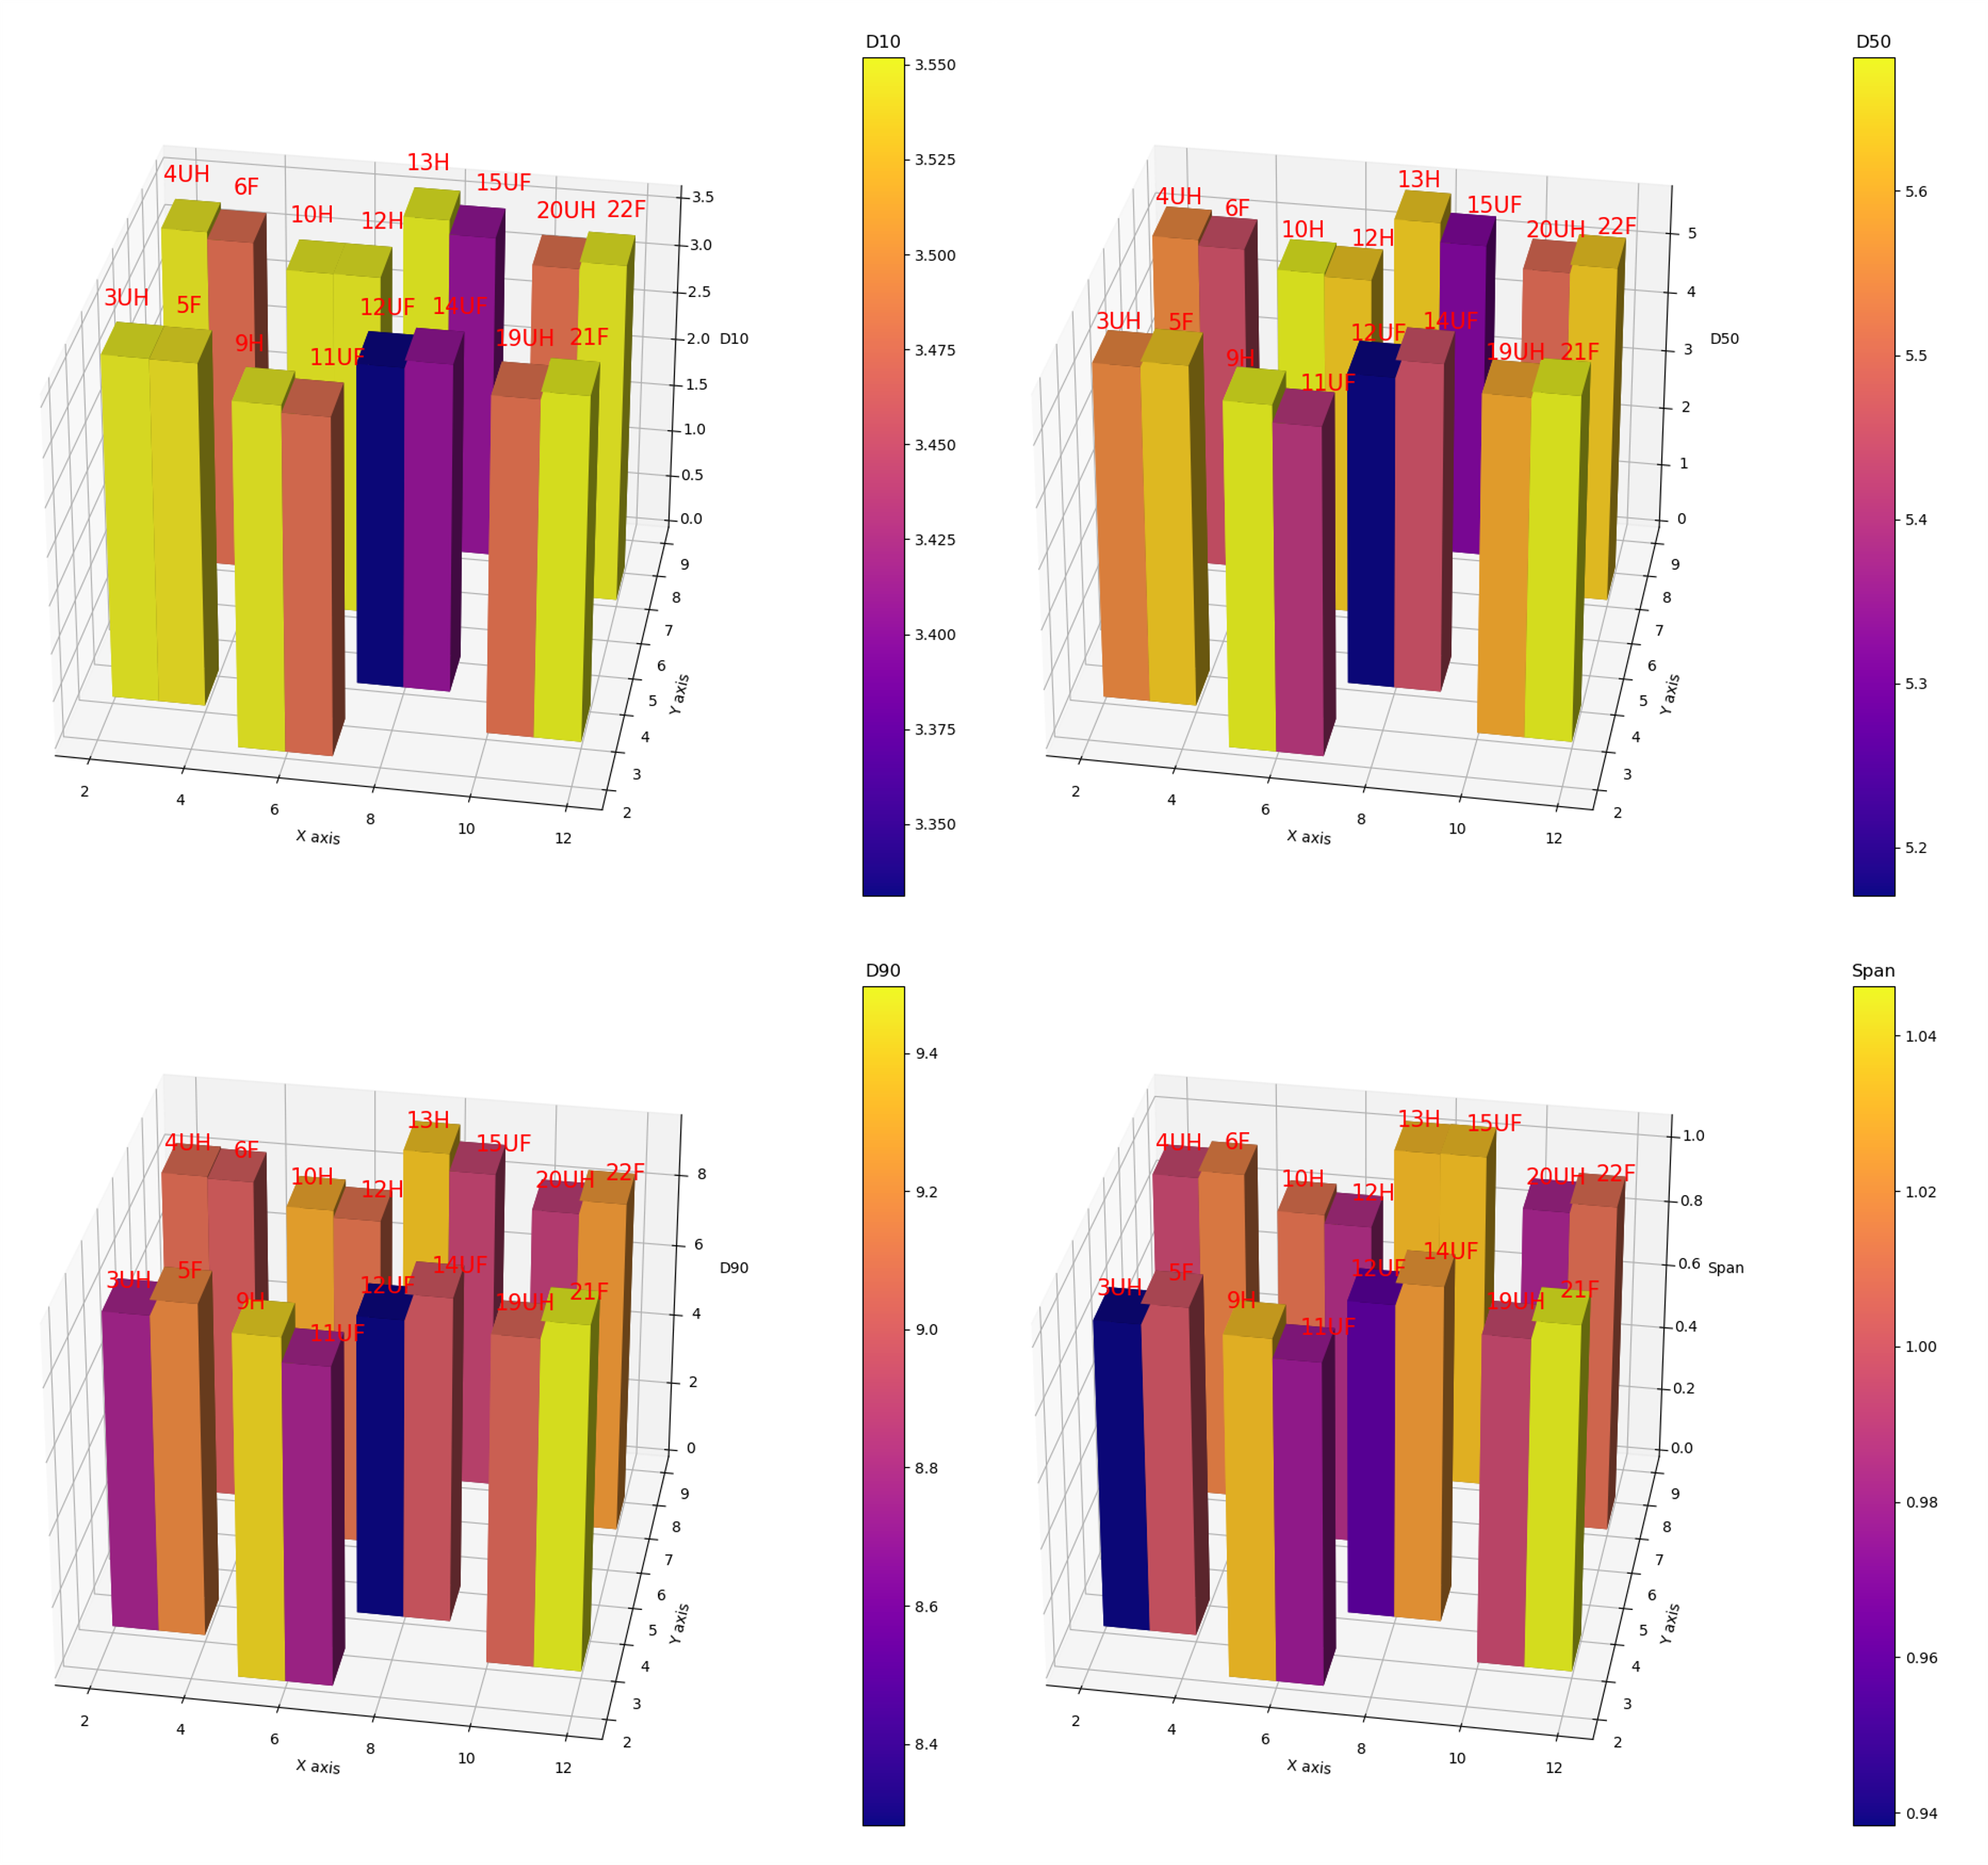

Slide 17
Comparison of D10, D50, D90 and Span for the 16 samples from the marked side with x20 magnification.

Slide 18
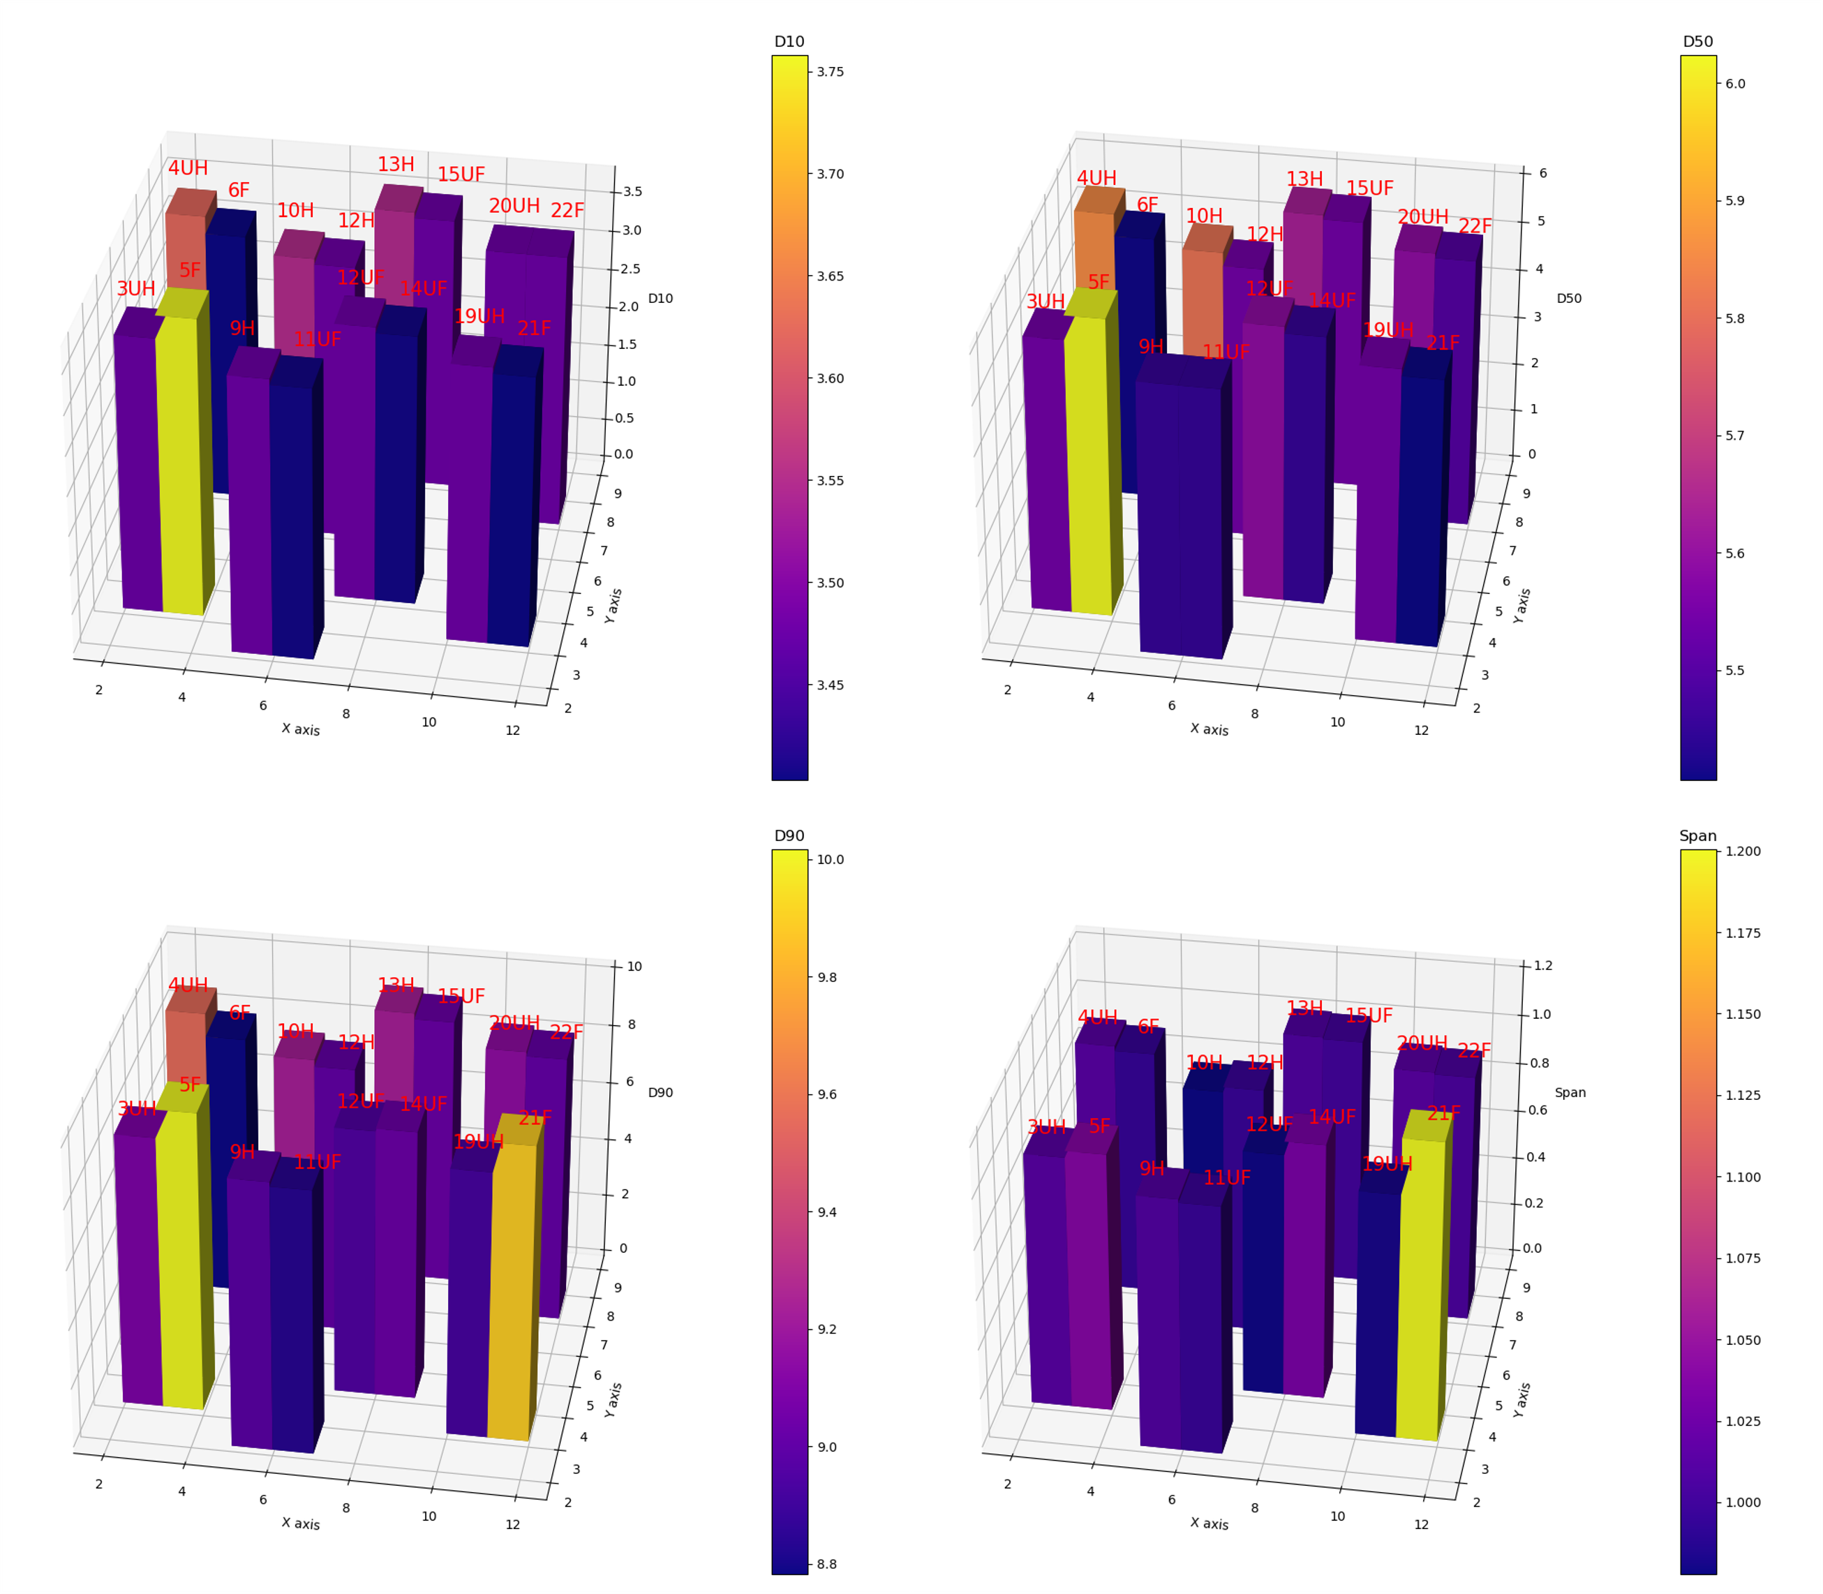

Slide 19
Comparison of D10, D50, D90 and Span for the 16 samples from the bottom with x20 magnification.

Slide 20
